Slide 1
Improve Taiwan Credit Approvals by Predicting Bank Defaults
ADSP 31009 Machine Learning & Predictive Analytics
Lexi Lin

Slide 2
Roadmap
Background and Objective
Data Description & Feature Engineering
Modeling, Methodologies, and Results
Feature Importance Analysis
Potential Improvements
Notes:
Overview on the objectives & goals of my project
Briefly describe the dataset I used. How I engineered the features to create new ones.
We will dive into the predictive models and technical methodologies
Finally, I will wrap up with some of the findings from analyzing the most important features in my best models, along with strategies to enhance the model further

Slide 3
Objectives
Background - Taiwan Credit Card Crisis
In February 2006, debt from credit cards and cash cards reached $268 billion USD. More than half a million people were unable to repay their loans. This issue resulted in significant economic and social problems. Careful review of the credit card customer data during this time can surface insights about default trends and patterns.
Objective - Help a major bank in Taiwan to predict the likelihood of a credit card user defaulting on their payments.
Explore best models to predict default accounts
Identify characteristics that lead to higher risk of defaulting
Provide insights that can aid banks in credit card approvals and setting reasonable credit limits
Notes:
The dataset I analyzed was gathered in late 2005 and is closely linked to the Taiwan Credit Card Crisis of 2006. During the time, more than half a million people in Taiwan were unable to repay their loans. Some people and their families committed suicide because of the debt, others became homeless due to repossession of their homes. By careful reviewing some of the credit card data during that time, I wanted to discover insights about default trends and patterns that can help prevent a financial crisis like the one in 2006 from happening again.
Main objective is to help a bank to predict the likelihood of credit card defaults. I’ll achieve this through three sub-goals:
First, I’d like to
It’s also critical that we identify

Slide 4
Data Description
Variable | Description
LIMIT_BAL | Amount of the given credit (NT dollar): it includes both the individual consumer credit and his/her family (supplementary) credit.
SEX | Gender (1 = male; 2 = female)
EDUCATION | Education (1 = graduate school; 2 = university; 3 = high school; 4 = others)
MARRIAGE | Marital status (1 = married; 2 = single; 3 = others)
AGE | Age (year)
PAY_1 to PAY_6 | Monthly repayment status from September to April 2005: PAY_1 = the status in Sept. 2005; PAY_2 = Aug. 2005; . . .;PAY_6 = Apr. 2005. The measurement scale for the repayment status is: -1 = pay duly; 1 = payment delay for one month; 2 = payment delay for two months; . . .; 8 = payment delay for eight months; 9 = payment delay for nine months and above.
BILL_AMT1 to BILL_AMT6 | Amount of bill statement. BILL_AMT1 = amount of bill statement in September, 2005;. . .; BILL_AMT6 = amount of bill statement in April, 2005.
PAY_AMT1 to PAY_AMT6 | Amount of previous payment. PAY_AMT1 = amount paid in September, 2005; PAY_AMT2 = amount paid in August, 2005; . . .;PAY_AMT6 = amount paid in April, 2005.
DEFAULT | Whether or not the customer defaulted on payments on or before October 2005
Customer’s default payment data collected by October 2005
Provided by a major bank in Taiwan
23 Features
30,000 Instances
Notes:
My analysis took credit card dataset collected in October, 2005, from a bank in Taiwan. It contains 30,000 observations and 23 original features. Short descriptions of the variables are shown on the slide.
For example, we have Limit Balance which is the total amount of credit a consumer can use. General Info about Customer: Gender, Education Level, Marital Status, Age.
I also want to call your attention to the features PAY_1 to PAY_6, these represent the monthly repayment status from April to Sept 2005. Specifically, PAY1 is the status in Sept
In terms of the measurement scale of the repayment status, Status value of a -1 means the customer has paid duly. Anything positive represents payment delay.
Data Cleaning
Converted the target variable ‘DEFAULT into binary integer value (1 is default, 0 is no default)
Checked for missing values
Converted all features, including categorical variables, into integer because some models such as XGBoost doesn’t support categorical variable data type.

Slide 5
Feature Engineering 1
Frequency Encoding
Calculate Bill Amount Ratios
EDUCATION
MARRIAGE
PAY_1, PAY_2,
…, PAY_6
BILL_AMT1, BILL_AMT2, …, BILL_AMT6
LIMIT_BAL
Education Frequency Encoded
Marriage Frequency Encoded
Pay_1 to Pay_6 Frequency Encoded
Bill Amount Ratio 1 to 6
Legend:
Original Predictor
Newly Created Predictor
Notes:
Since the number of features are limited to start with, I used several feature engineering techniques to create new predictors.
Frequency Encoding
I applied frequency encoding to EDUCATION, MARRIAGE, PAY_1 to PAY_6 based on how often a category appears in the variable. This created 8 new features to my dataset.
Bill Amount Ratio Variables
By dividing the bill amount each month by the credit limit, I derived the new features "Bill_Amt_Ratio". They represent the monthly bill amount as a percentage of the credit limit.

Slide 6
Feature Engineering 2
Interaction Terms
Payment Late for Multiple Months
AGE
PAY_1, PAY_2,
…, PAY_6
EDUCATION
LIMIT BAL
Consistently Late 2 Months
Consistently Late 3 Months
Consistently Late 4 Months
Age Education
Age Limit Balance
Legend:
Original Predictor
Newly Created Predictor
Notes:
3. To capture the late payment patterns, I built three new features indicating whether a customer has consistently paid late for 2, 3, and 4 months.
Last but not least, I added the interaction terms for AGE and other variables to capture the correlation between a customer's age and their education and limit balance.
In the Pay columns, positive values indicates that there is payment delay (e.g., 1 means 1 month late, 2 means 2 months late), so I applied logical operations to these payment history variables and derived new features to document whether there are consistent late payments.

Slide 7
Modeling Framework
Tree Models
Decision Tree
Random Forest
Gradient Boost
AdaBoost
XGBoost
Other Models
KNN
SVM (linear and kernel)
Gaussian Naïve Bayes
Evaluation Metrics
F1-score
AUC
Confusion Matrix
Procedure
Cross Validation
Fine Tuning
Select best model from each category
Neural Network
Multi-Layer Perceptron (MLP)
Stacking Ensemble
Notes:
To efficiently compare the performance of various predictive models, I designed a modeling framework by categorizing the models into four groups: tree-based models, other models (like KNN, SVM, and Naive Bayes), Neural Network (MLP), and Stacking Ensemble. The goal was to select the best-performing model from each category and compare them, particularly with MLP and Stacking Ensemble.
Since the primary objective of this analysis is to correctly identify default accounts, identifying true positives is more critical than true negatives. To measure this, I prioritized the F1 score, as it combines both recall and precision into a single metric to evaluate the quality of identifying defaults. Additionally, I used AUC from ROC curves and confusion matrices as complementary metrics. These helped evaluate the overall ability of each model to distinguish between classes.
For each model category, I followed a structured procedure: performing cross-validation to assess initial performance, then selecting the top 2-3 models for fine-tuning and testing. Finally, the best model from each category was compared to the Neural Network and Stacking Ensemble to determine the overall best-performing model.

Slide 8
Technical Methodologies
Initial Training Phase
Repeated Stratified K Fold: ensure the splits in the dataset preserves the same class distribution in each fold as the original data
Cross Val Score: compute validated scores for all folds
Average F1 Score: compute average initial f1 score for the model
Fine Tuning Phase
Hyperparameter Tuning
GridSearchCV
Threshold Tuning
ROC Curve
Youden’s Index
AUC
Performance Evaluation
Final F1-Score
AUC
Confusion Matrix
Select 2-3 Best Models
Notes:
This slide illustrates the functions and methodologies that I repeated in each category.
By using repeated stratified K fold and cross validations, I computed the initial f1 scores for each model. The top models are further refined using GridSearchCV for hyperparameter tuning and ROC Curve for threshold calibrations. The final top model for the category is determined based on the final F1 Scoe, AUC, and confusion matrices.
During the initial training phase,
I applied Repeated Stratified K Fold to stratify the sampling by the class label. And then cross validated the training set 5 times to find the averaged F1 score for each model. After computing the initial f1 scores, the top 2-3 models with the best scores are selected to proceed into the fine tuning phase. For hyperparameter tuning, GridSearchCV helped me to find the most optimal parameter values for the selected models.
With the updated parameters, I plotted ROC Curves which identifies the point resulting in the biggest area as the best threshold for the model. In my code, I used Youden’s Index (Youden’s J statistic) to calculate the maximum vertical distance between the ROC curve and diagonal line. The ROC curve also provides a critical metric Area Under Curve (AUC) which tell us how much the model is capable of distinguishing between classes. Basically, the higher the AUC, the better the model is at distinguishing b/w default vs. non-default customers.
After updating the optimal threshold values and hyperparameters, I evaluated the models on test again to obtain the final f1-score and confusion matrix. The final top model from each category is determined based on the final f-1 score, AUC, and confusion matrix.
(where I fined tuned the hyperparameter values and adjusted classification thresholds.)
(Since there’s class imbalance in my data, this technique ensures that the splits in the dataset preserves approximately the same class distribution in each subset/fold as in the original dataset.)

Slide 9
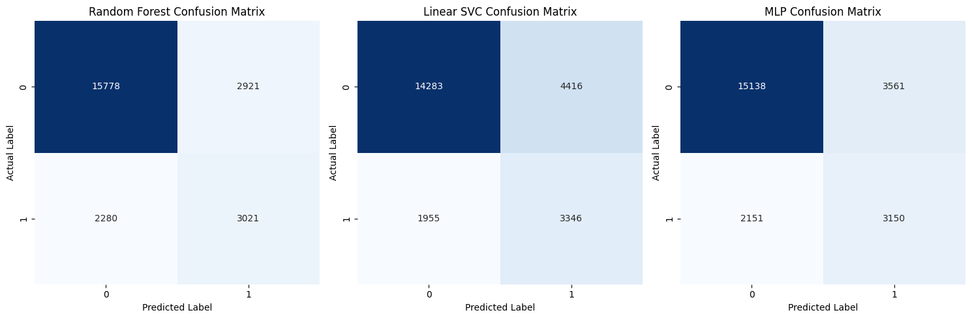
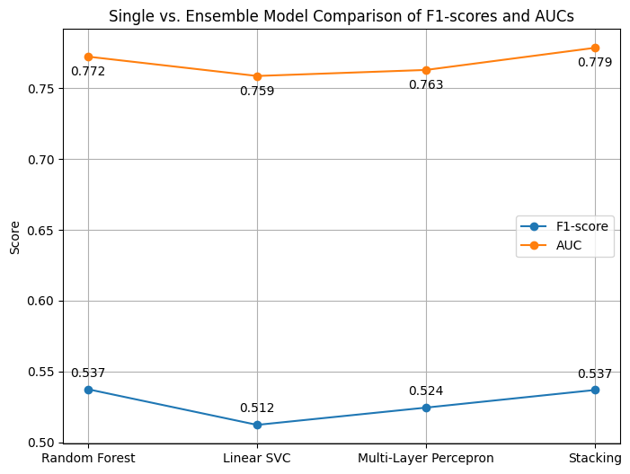
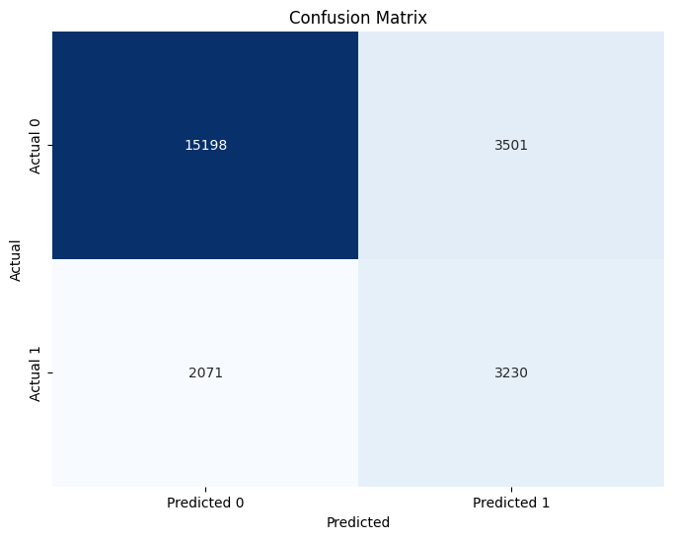
Final Model Selection: Single vs. Ensemble
Notes:
Due to time constraints, I will skip the parts where I compared the models in the first two categories. Like Jeff said, these are explained in my code but you have to take my word for it that the winner of the tree models branch is Random Forest, and the model with the best performance in all the other models is Linear SVM. Multi-Layer Perceptron also demonstrated strong performance comparable with the top models from the two other branches.
Using Random Forest and LSVC as the base learners and logistic regression as the meta-model, I built a stacking ensemble attempting to create a fusion of two top models that are better than each one of them alone. But as you can see on the slide, the Stacked Ensemble is not much different than a single Random Forest. Since the ensemble requires more computational resources and time than a single model, so I don’t think its performance is worth the additional computations.
In the other three models, Random Forest achieved the highest f1 measure of 0.537 and AUC of 0.772, demonstrating its reliability in predicting default customers while optimizing the precision. MLP showed more robust performance in identifying the true positive instances than Random Forest but at a cost of slightly lower precision.
In summary, I’d recommend Random Forest as the final model if the bank prioritizes overall reliability and interpretations of the predictions. Its high f1 score and AUCs demonstrates the best capability to distinguish between classes and high reliability of the predicted true instances. However, if large datasets and complex patterns are expected, then MLP provides a competitive alternative. MLP is capable of identifying more positive instances than Random Forest, even though at a cost of decreased precision.
The final decision as to which model to implement stays with the bank's business stakeholders, but my dual recommendation ensures that the final model choice aligns closely with the bank's operational priorities and objectives.

Slide 10
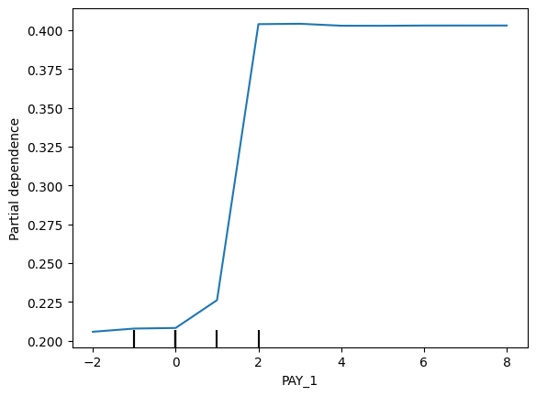
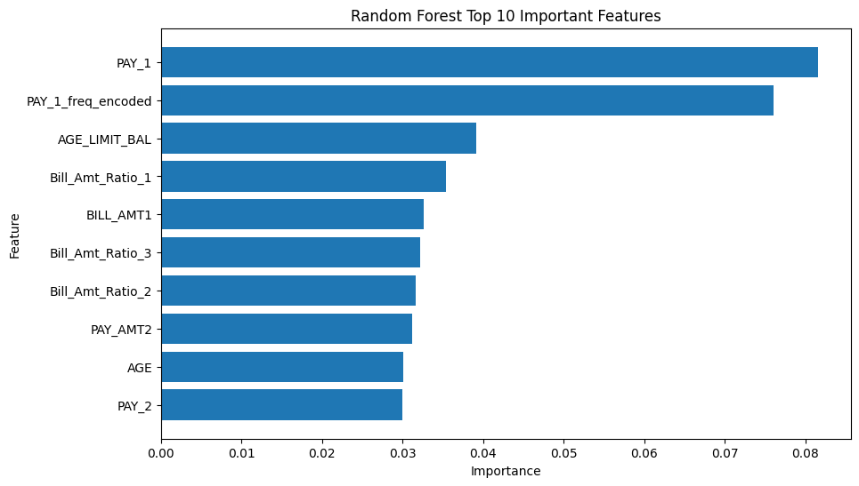
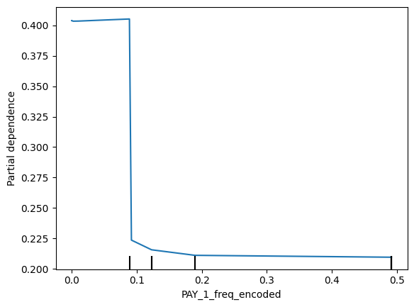
Feature Importance Analysis
Notes:
This slide shows the feature importance and partial dependence plots (PDPs) for the key features identified in the Random Forest model.
From the graph on the left, we see that the most important factors influencing default predictions are the most recent repayment status (PAY_1) and the frequency of this repayment status (PAY_1_freq_encoded). These two features have importance values significantly higher than all other features combined.
Specifically, PDPs for PAY_1 shows a clear trend: the higher the values of PAY_1, the longer the payment is delayed, and the more the predicted probability of default increases. This suggests that the customers with very recent payment delays are more likely to default.
The PDPs for PAY_1_freq_encoded demonstrates a more pronounced yet interesting trend. As the frequency increases, the probability of default goes down. But when frequency lowers, the probability of default increases rapidly. This highlights that stability is the key - when new infrequent actions emerge, they are likely to be indicators of default. This finding is intuitive as well. If we suddenly see unusual payment delays from a customer who had been diligently making the payments in the past, they must have encountered serious financial challenges. The more unusual the actions are, the more serious the problem is, and the less likely they are to recover form the setback quickly, leading to default.

Slide 11
Potential Improvements
Data Augmentation: collecting more financial data about customers (e.g., household income, spending habits, ownership of properties)
Offline and Online Data: decompose dataset into offline and online components using data distribution of a similar credit card transaction dataset
Dimensionality Reduction: explore techniques such as PCA
Notes:
To further improve the model performance and continue the analysis, we can consider the following strategies:
Data Augmentation: This dataset doesn't provide any information about customers' household income, spending habits, ownership of properties, and the existance of other checking or savings accounts. These information, although auxiliary and difficult to obtain, are pivotal to determine a person's loan repayment ability for appropriate credit setting. Collecting and analyzing additional financial data about the customers can potentially increase our model performance and offer more insights.
Offline and Online Data: We can decompose this dataset into offline and online components. The offline data would contain demographic data and total payment summary of the customer. The online dataset includes each payment and bill amount by every customer.
3. Dimensionality Reduction: We could try exploring techniques such as Principle Component Analysis (PCA) to reduce the number of features while retaining most of the information. This can help simplify the model and potentially improve the generalization ability.
(From here, it would be valuable to extract individual transaction data by breaking down the payments and bills into more granular transactions. This will require data augmentation or using data distribution of a similar credit card transaction dataset. Either way, the technique to divide the dataset into two parts will create more complications for this problem, but it can help us to calculate a total risk probability where the Total Risk = Risk probability from online data + Risk probability from offline data.)

Slide 12
References
https://archive.ics.uci.edu/dataset/350/default+of+credit+card+clients
https://sevenpillarsinstitute.org/case-studies/taiwans-credit-card-crisis/

Slide 13
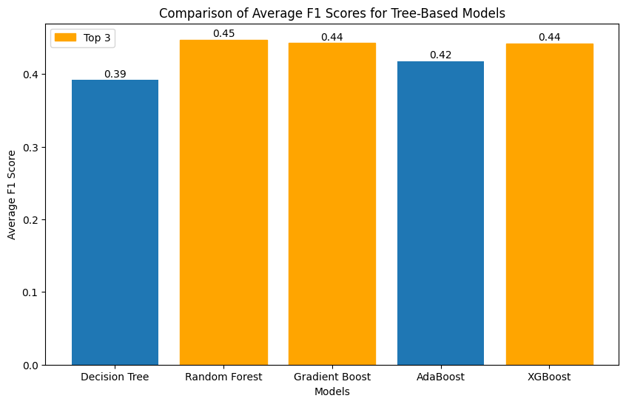
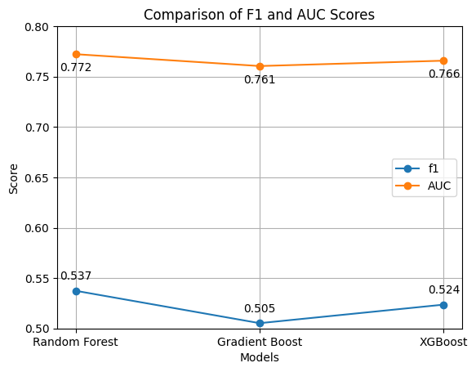
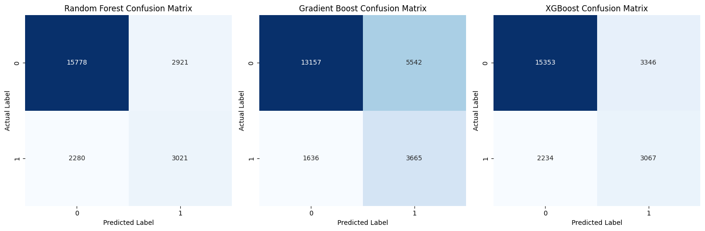
Tree Models - Results
Fine Tuning
Random Forest performs the best in all key metrics, so it is the winner of the tree models.
Initial Training
After computing the initial f1 scores, the top 3 models are RF, GB, and XGBoost
Notes:
The first category are the tree-based models, including decision tree, random forest, gradient boost, AdaBoost, and XGBoost. The bar plot on the left shows the initial validation scores for each of the models, and the top 3 models are Random Forest, Gradient Boost, and XGBoost.
After fine tuning, random forest achieves the highest F1 score, demonstrating a good balance between precision and recall. XGBoost closely follows random forest in the second place. Both models perform significantly better than gradient boost.
When comparing the confusion matrices, XGBoost has a slight edge than RF in the true positive instances but the differences are small. Also, we can see that to obtain small increase in the true positives, XGBoost resulted in higher number of false positives, leading to lower F1 score. Overall, random forest performs the best in all key metrics so it is the winner of the tree models.
(When comparing the confusion matrices, we can see the reasons why gradient boost performs worse than the other models - it produces too many false positives (upper right square), even though it also predicted the highest number of true positve instances.
Random forest and XGBoost demonstrates similar performance in capturing the true labels. Specifically, random forest performs slightly better in the true negatives, and XGBoost has a slight edge in the true positive instances, but the differences between the models are small. However, we can see that to obtain small increase in the true positives, XGBoost resulted in higher number of false positives than random forest, leading to slightly lower f1 score in comparison. Although the performances of the two models are close, random forest performs the best in all key metrics so it is the winner of the tree models.)

Slide 14
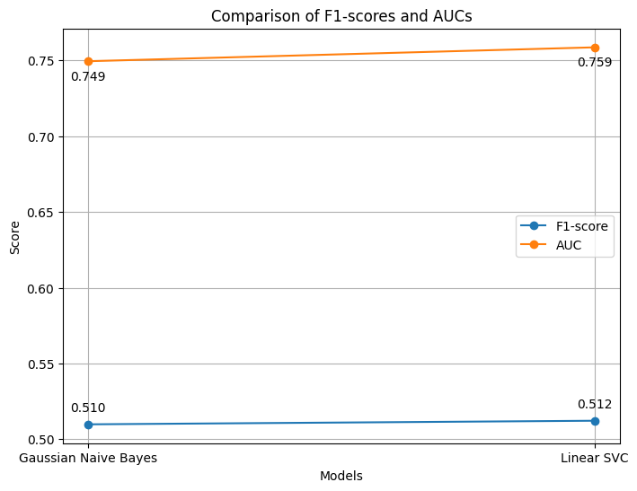
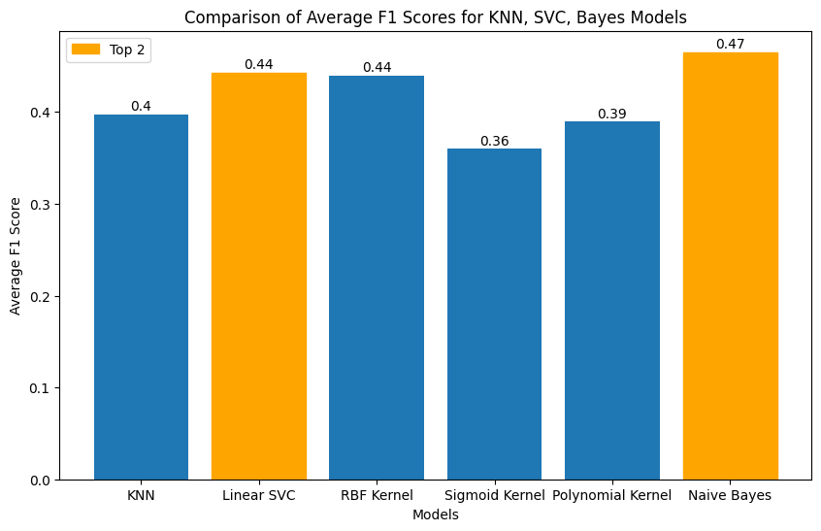
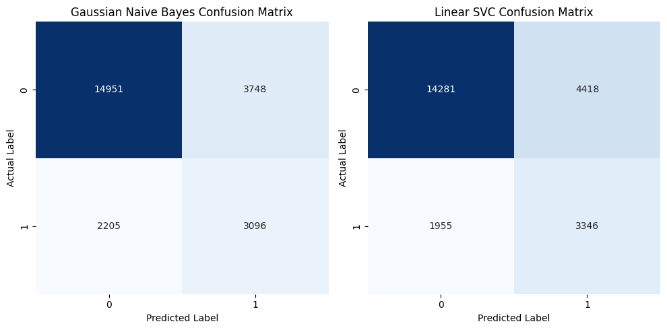
SVM, Bayes, KNN Models – Results
Fine Tuning
Linear SVC demonstrates better ability to predict the positive classes
Initial Training
After computing the initial f1 scores, the top 2 models are LSVC and Naïve Bayes
Notes:
In the second category of models, I analyzed SVM, Bayes, and KNN models. By repeating the same cross validation procedure as before , I obtained the average f1 scores for all the models. The results of the f1 scores are shown on the left plot. Among these, I selected the best model from the SVCs which is the Linear SVC, and the top model from KNN and Bayes, which is the Bayes model to proceed to the fine tuning phase.
After parameter tuning and threshold calibrations, the final F1 score and confusion matrix of the two models are shown on the right. The line plot shows that while both models achieved similar AUCs (0.759 for Linear SVC and 0.749 for Naive Bayes), the Linear SVC outperformed Gaussian Naive Bayes in terms of F1-score, achieving 0.512 compared to Naive Bayes’ 0.510.
Looking at the confusion matrices, the Linear SVC demonstrates better ability to predict the positive classes, with 3,346 true positives compared to Naive Bayes' 3,096, while also reducing the number of false negatives. This suggests that Linear SVC is more effective at identifying default accounts and provides an overall better performance.
(Most models have f1 scores around 0.4 to 0.5, this result is similar to the tree models.)
(I used the same parameter tuning and threshold calibration functions as before on the Linear SVM and Naïve Bayes, giving rise to the ROC curves for both models as shown on the slide. After all the adjustments, the final F1 score and confusion matrix for each model is evaluated on the test set. )

Slide 15
Artificial Neural Network
Sequentially loop through each category of the hyperparameters
activation functions = ['identity', 'logistic', 'tanh', 'relu']
optimization functions = ['lbfgs', 'sgd', 'adam']
alpha values = [0.0001, 0.001, 0.01, 0.1, 1.0]
Hidden layer configs = [(100,), (50,50), (30,30,30)]
Repeated Stratified K Fold
Cross Validation
Average F1-Score
Hyperparameter Tuning
Best Combination: MLPClassifier(activation='identity', solver='adam',alpha=0.01, hidden_layer_sizes=(100,), random_state=63)
Notes:
For neural networks, ANN is the only type of deep learning model most suitable to solve this problem, so I applied Multi-Layer Perceptron to this dataset to obtain the initial F1 Score. Instead of doing GridSearch for hyperparameter tuning, this time I looped through the hyperparameters to find the parameter with the best f1 score. The most optimal combination of the parameters are listed at the bottom of the slide.

